Slide 1
Object Oriented Programming Through Java
LAD
Presented By
Mr. L. Atri Datta Ravi Tez
Assistant Professor
Dept of CSE

Slide 2
Course Outcomes
LAD
The learning objectives of this course are to:
• identify java language components and how they work together in applications
• learn the fundamentals of object-oriented programming in java, including defining classes, invoking methods, using class libraries.
• Learn how to extend java classes with inheritance and dynamic binding and how to use exception handling in java applications
• understand how to design applications with threads in java
• understand how to use java apis for program development

Slide 3
Introduction
LAD
Java is an object-oriented programming language developed by james goshling in the year 1996 at sun micro systems (which is now a subsidiary of oracle corporation). Much of its syntax is taken from c and c++. Initially it was called oak and later it is changed to java.
Actually it was designed for embedded application and later it was changed to support web and enterprise applications.
We can download java software from www.Java.Sun.Com from java1.6 java is open source.
As per sun microsystems (oracle acquired sun microsystems in 2010) java has three editions
J2SE/javase → java 2 standard edition
J2EE/javaee → java 2 enterprize edition
J2ME/javame → java 2 micro edition

Slide 4
Introduction
LAD
J2se/javase:
J2se is used to develop the standalone applications, desktop application, console applications. ( Client-side applications)
Standalone application: runs in the context of a local disk.
Ex: notepad
Desktop application: runs stand-alone in a desktop or laptop computer.
Ex: file explorer, ms office applications
Console application: run in consoles (the command prompt in windows).
Ex: bank atm
For developing j2se applications we need the java development kit (jdk). Jdk contains the compile time environment and the runtime environment. The compiler environment is provided by javac compiler and the runtime environment is provided by java virtual machine(jvm)

Slide 5
Introduction
LAD
J2EE/JAVAEE: J2EE is used to develop web, distributed, enterprise applications. (Server-side applications)
Web application: able to access via internet.
Ex: gmail, shopping cart, photo editing, file conversion
Distributed application: exists on multiple machines and at multiple platforms. Ex: web browsers.
Enterprise application: use to assist the organization in solving enterprise problems.
Ex: crm (customer relationship management), erp (enterprise resource planning

Slide 6
Introduction
LAD
J2ME/JAVAME: J2ME is used to develop mobile and embedded applications. (Mobile devices)
Mobile application: run on a mobile device, such as a smartphone or tablet computer. Ex: downloaded from google play store, app store(ios).
Embedded application: placed permanently inside some kind of device to perform a very specific set of functions.
Ex: video game consoles, GPS, microwave oven

Slide 7
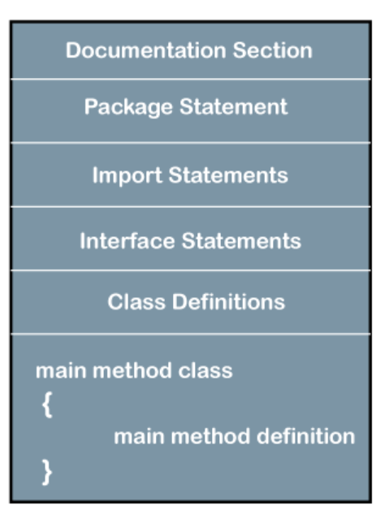
Structure of Java Program
LAD

Slide 8
Structure of Java Program
LAD
Structure of a java program contains the following elements:
Documentation section
Package declaration
Import statements
Interface section
Class definition
Class variables and variables
Main method class
Methods and behaviors

Slide 9
Structure of Java Program
LAD
Documentation section
The documentation section is an important section but optional for a java program. It includes basic information about a java program. The information includes the author's name, date of creation, version, program name, company name, and description of the program. It improves the readability of the program. Whatever we write in the documentation section, the java compiler ignores the statements during the execution of the program. To write the statements in the documentation section, we use comments. The comments may be single-line, multi-line, and documentation comments.

Slide 10
Structure of Java Program
LAD
Single-line comment: it starts with a pair of forwarding slash (//). for example:
//First java program
Multi-line comment: it starts with a /* and ends with */. we write between these two symbols. For example:
/*It is an example of
Multiline comment*/
Documentation comment: it starts with the delimiter (/**) and ends with */. for example:
/**It is an example of documentation comment*/

Slide 11
Structure of Java Program
LAD
Package declaration
The package declaration is optional. It is placed just after the documentation section. In this section, we declare the package name in which the class is placed. Note that there can be only one package statement in a java program. It must be defined before any class and interface declaration. It is necessary because a java class can be placed in different packages and directories based on the module they are used. For all these classes package belongs to a single parent directory. We use the keyword package to declare the package name.
Ex:-Package cst;

Slide 12
Structure of Java Program
LAD
Import Statements
He package contains the many predefined classes and interfaces. If we want to use any class of a particular package, we need to import that class. The import statement represents the class stored in the other package. We use the import keyword to import the class. It is written before the class declaration and after the package statement. We use the import statement in two ways, either import a specific class or import all classes of a particular package. In a java program, we can use multiple import statements.
Ex:-import java.util.*;

Slide 13
Structure of Java Program
LAD
Interface Section
It is an optional section. We can create an interface in this section if required. We use the interface keyword to create an interface. An interface is a slightly different from the class. It contains only constants and method declarations. Another difference is that it cannot be instantiated. We can use interface in classes by using the implements keyword. An interface can also be used with other interfaces by using the extends keyword. For example:
Ex:-interface car
{
void start();
void stop();
}

Slide 14
Structure of Java Program
LAD
Class Definition
In this section, we define the class. It is vital part of a java program. Without the class, we cannot create any java program. A java program may conation more than one class definition. We use the class keyword to define the class. The class is a blueprint of a java program. It contains information about user-defined methods, variables, and constants. Every java program has at least one class that contains the main() method. For example:
Ex:-class Student
{
…………
…………
}

Slide 15
Structure of Java Program
LAD
Class variables and constants
In this section, we define variables and constants that are to be used later in the program. In a java program, the variables and constants are defined just after the class definition. The variables and constants store values of the parameters. It is used during the execution of the program. We can also decide and define the scope of variables by using the modifiers. It defines the life of the variables.
Ex:-Class student //class definition
{
String sname; //variable
Int id;
Double percentage;
}

Slide 16
Structure of Java Program
LAD
Main method class
In this section, we define the main() method. It is essential for all java programs. Because the execution of all java programs starts from the main() method. In other words, it is an entry point of the class. It must be inside the class. Inside the main method, we create objects and call the methods. We use the following statement to define the main() method:
Syntax: public static void main(string args[])
{
}

Slide 17
Structure of Java Program
LAD
Methods and behavior
In this section, we define the functionality of the program by using the methods. The methods are the set of instructions that we want to perform. These instructions execute at runtime and perform the specified task.
For example:Public class demo //class definition
{
public static void main(string args[])
{
void display()
{
System.Out.Println("welcome to javatpoint");
}
//statements
}
}

Slide 18
Features of Java
LAD
Object oriented : java is a object oriented programming language as it supports the object oriented features such as
➢ objects
➢ class
➢ data abstraction
➢ data encapsulation
➢ inheritance
➢ polymorphism
➢ dynamic binding
➢ message passing

Slide 19
Features of Java
LAD
Simple : java is a simple programming language, as the difficult concepts of C and C++ such as
▪ Pointers
▪ operator overloading
▪ unsigned data types
▪ virtual functions
▪ multiple inheritance through classes
▪ structures & unions
▪ templates
▪ variable aliases (typedef) it also uses same syntax of C and C++, so it is easy for a programmer who is familiar with C or C++.

Slide 20
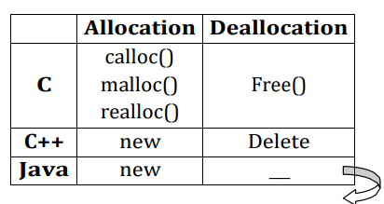
Features of Java
LAD
Portability ( platform independent+architecutural neutral):
A language or technology is said to be portable if and only if java application runs on any kind of OS architecture and processor architecture.
Robust : java is a robust i.E strong the java programs are strong and they don’t crash easily like a c/c++ programs because of the following reasons.
➢ Implicit memory management
➢ Run time errors handling (exception handling)
Implicit memory management : in java the memory required for the program is allocated dynamically and the unused objects are automatically garbage collected
Automatically done by Garbage Collector in JVM

Slide 21
Features of Java
LAD
Dynamic: java programs generate dynamic content. (Applets, dynamically interacting programs on internet)
Interpreted: java programs are compiled to generate the byte code. This byte code can be downloaded and interpreted by the interpreter in JVM. In java, we use both compiler and interpreter for the execution.
High performance: the problem with interpreter inside the jvm is that it is slow, by this java programs used to run slow. To overcome this problem, along with the interpreter, JIT (just in time) compiler was introduced which enhances the speed of execution. So, now in JVM, both interpreter and JIT compiler work together to run the program.
Multithreaded: multithreaded is a capability for a program to perform several tasks simultaneously within a program. A thread represents an individual process to execute group of statements. JVM uses several treads to execute different blocks of code. Creating multiple threads is called ‘multithreaded’. Ex: game software, which uses multiple threads simultaneously for GUI display, sound effects, timer control, score updating. In network programming, a sever can serve multiple clients at the same time via multithreading

Slide 22
Features of Java
LAD
Distributed: java introduces JAVA EE for distributed development. Using java, we can write programs, which capture information and distribute it to the clients as java can handle the protocols such as TCP/IP and UDP. A distributed application exists on different machines and at different locations
Secured: security problems like eavesdropping, tampering, impersonation, and virus threats can be eliminated or minimized by using java on internet. Virus: A program that can damage data, software or hardware of a computer. Virus spreads fast through .Dat, .Exe, .Com. Virus does not affects the .Txt. Eaves dropping: reads others data illegally. Tampering: not only reads data but also modifies it. Impersonation: A person acting as another on internet. JVM take cares of security

Slide 23
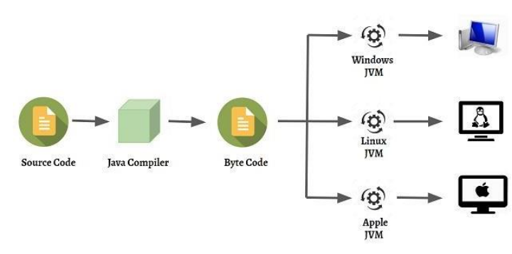
Features of Java
LAD
Plat form independent : java is a platform independent language. A plat form is the hardware and software environment on which a program executes.
Once java code compiled on one platform and will run on any platform without making any changes i.E., Write once run any where
Platform independence is possible by making use of Java Virtual Machine (JVM). When we compile a java program, the .class file is generated which contains the byte code i.e., each instruction is expressed in the form of bytes. Byte code is understandable by JVM not by the machine. JVM interprets byte code into machine understandable format

Slide 24
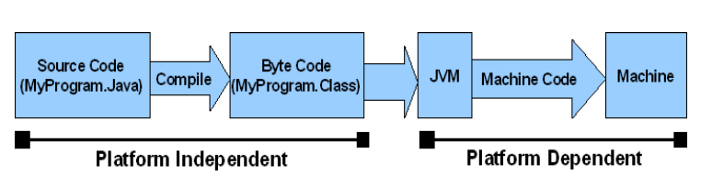
Features of Java
LAD

Slide 25
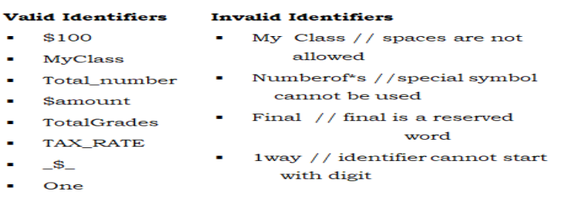
Java Identifiers
LAD
Java identifiers :
An identifier is a name given to the variable, constant, method, class, package, etc.,
Rules for constructing the identifiers
The first character of an identifier must be a letter, an underscore(_) or a dollar sign($)
The rest of the characters in the identifier can be alphabet, digit, underscore(_) or dollar($).
No special symbols are allowed in the identifier except underscore(_) and dollar($).
Reserved words cannot be used as the identifiers
Java identifiers are case sensitive

Slide 26
Java Identifiers
LAD
Java naming conventions:
Code conventions improve the readability of the software allowing engineers to understand new code more quickly and thoroughly
Naming conventions for classes: it starts with a uppercase letter and internal word also starts with uppercase letter. Rest of the characters are lower case.
Ex: class Demo class MyFirstClass
{ {
---------- - - - - - - - - } }

Slide 27
Java Identifiers
LAD
Java naming conventions:
Code conventions improve the readability of the software allowing engineers to understand new code more quickly and thoroughly
Naming conventions for classes: it starts with a uppercase letter and internal word also starts with uppercase letter. Rest of the characters are lower case.
Ex: class demo class myfirstclass
{ {
---------- - - - - - - - - } }
Naming conventions for interfaces:
it starts with a uppercase letter and internal word also starts with uppercase letter. Rest of the characters are in lower case.
Ex: interface demo interface
myfirstclass { { } } predefined interfaces are : runnable, clonable, serializable

Slide 28
Java Identifiers
LAD
Naming conventions for variables:
it begins with a lowercase letter and internal word also starts with uppercase letter. Rest of the characters are in lower case.
Ex: int x; int age; int myfirstsalary;
Naming conventions for constants:
it consists of all uppercase letters. Internal words are separated by an underscore (_)
Ex: flaot TAX_RATE =0.56f;
int MAX_VALUE=567;
Naming conventions for methods :
It start with a lowercase letter and internal word also starts with uppercase letter. Rest of the characters are in lower case.
Ex : public void getData() { } public void setData()

Slide 29
Java Identifiers
LAD
Naming conventions for packages :
Packages names are written in lowercase letter.
Ex : java.Lang
java.Io
java.Net
java.Awt
animal
mypack

Slide 30
Java Comments
LAD
Java comment lines:
Comments increase the readability of the application.
They are ignored by the compiler.
Java supports three types of comments:
1. Single line comment → //-----comment-----
2. Multi-line comment → /* -----comment ----- */
3. Document comment → /** ---documentation --- */
The documentation comment is used to create documentation API. To create documentation API, you need to use javadoc tool.

Slide 31
Java Comments
LAD
Use of documentation comment:
Suppose the java file is first.Java then
compile it by javac tool:
javac first.Java create documentation API by javadoc tool:
Javadoc first.Java
Now, there will be HTML files created for your calculator class in the current directory. Open the HTML files and see the explanation of calculator class provided through documentation comment.

Slide 32
Variables
LAD
A variable is a identifier whose value is not fixed
Variables can be classified into three types
Local variable
Instance variable
Static variable
Local Variable
A variable declared inside the body of the method is called local variable. You can use this variable only within that method and the other methods in the class aren't even aware that the variable exists.
A local variable cannot be defined with "static" keyword.

Slide 33
Variables
LAD
Instance Variable
A variable declared inside the class but outside the body of the method, is called an instance variable. It is not declared as static.
It is called an instance variable because its value is instance-specific and is not shared among instances.
Static Variable
A variable that is declared as static is called a static variable.
It cannot be local. You can create a single copy of the static variable and share it among all the instances of the class.
Memory allocation for static variables happens only once when the class is loaded in the memory.

Slide 34
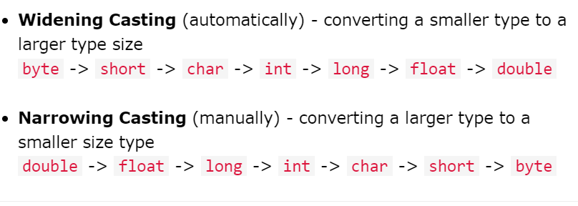
Type Casting
LAD
Type casting is when you assign a value of one primitive data type to another type.
In java, there are two types of casting:

Slide 35
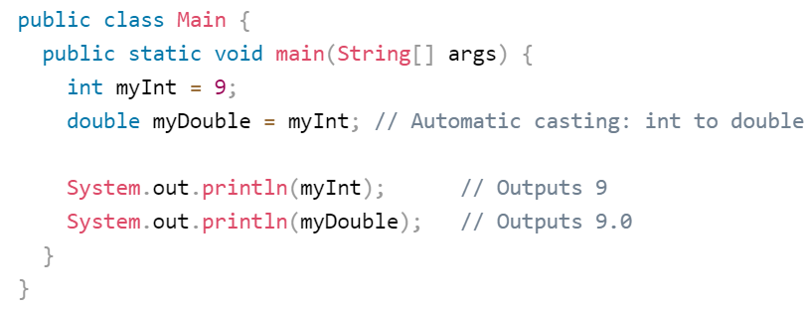
Ex of Widening Casting
LAD

Slide 36
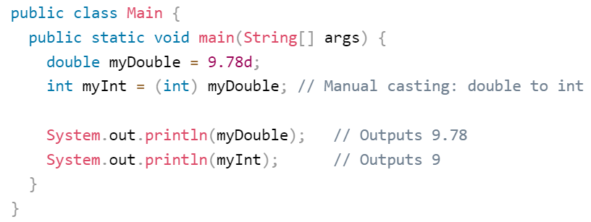
Ex of Narrowing Casting
LAD

Slide 37
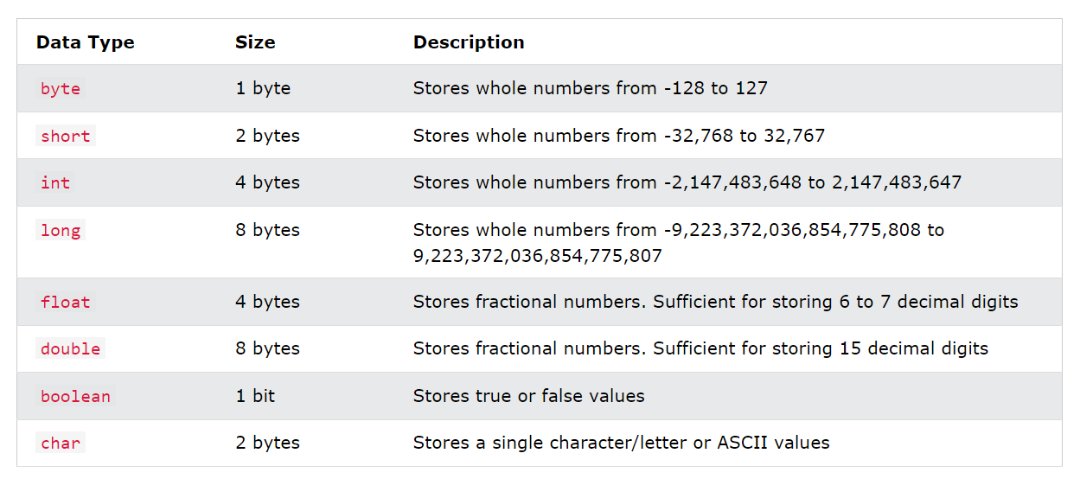
Data Types
LAD
Data types specify the different sizes and values that can be stored in the variable. There are two types of data types in java:
Primitive data types: the primitive data types include boolean, char, byte, short, int, long, float and double.
Non-primitive data types: the non-primitive data types include classes, interfaces, and arrays.

Slide 38
Operators
LAD
An Operator is a symbol which is used to perform certain operations on a particular value or variable.
Types of Operators
Arithmetic Operators
Relational/ Comparison Operators
Logical Operators
Increment/Decrement Operators
Assignment Operators
Shorthand Assignment Operators
Bitwise Operators
Special Operators

Slide 39
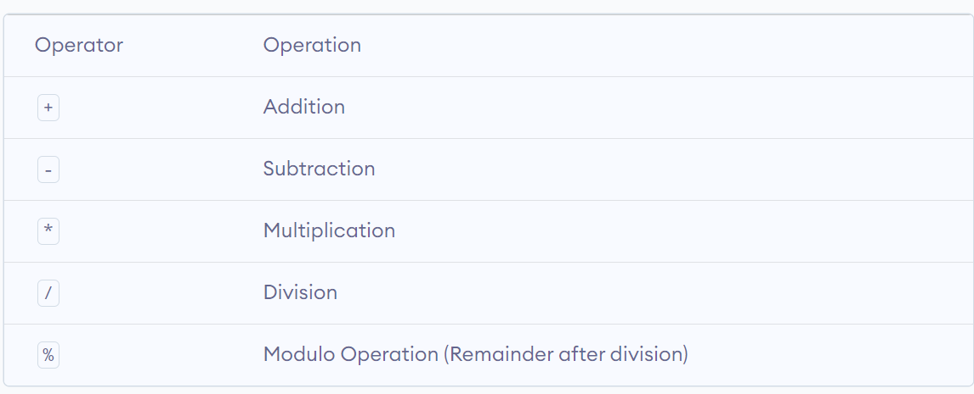
Arithmetic Operators
LAD
Integer Arithmetic:-
When both the operands in a single arithmetic expression such as (a+b) is an integer then the expression is called integer expression. The operator is called integer arithimetic
Ex: int a, b, c;
(a+b)

Slide 40
Arithmetic Operators
LAD
Mixed Mode Arithmetic:
When one of the operands is real and the other is integer, the expression is called a mixed mode arithmetic.
Ex:- int a;
float b, c;
c=a+b;

Slide 41
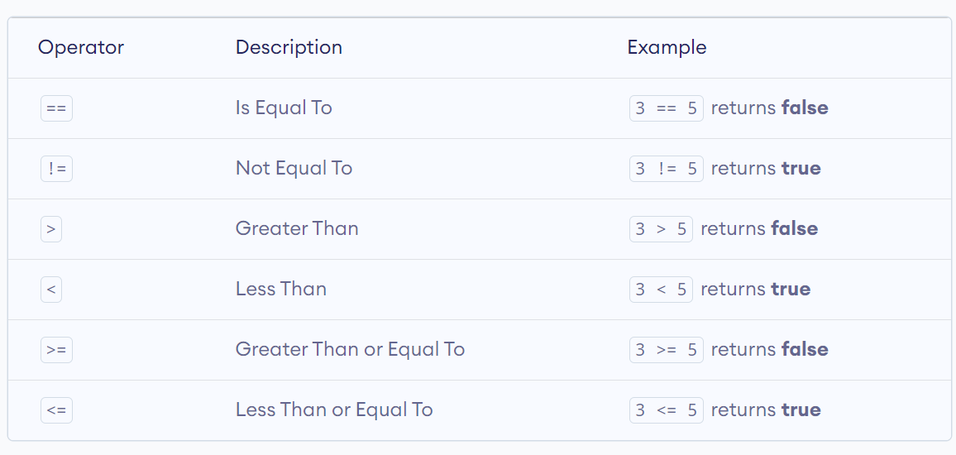
Relational Operators
LAD
Relational operators are used to perform comparsion between the two or more variables.

Slide 42
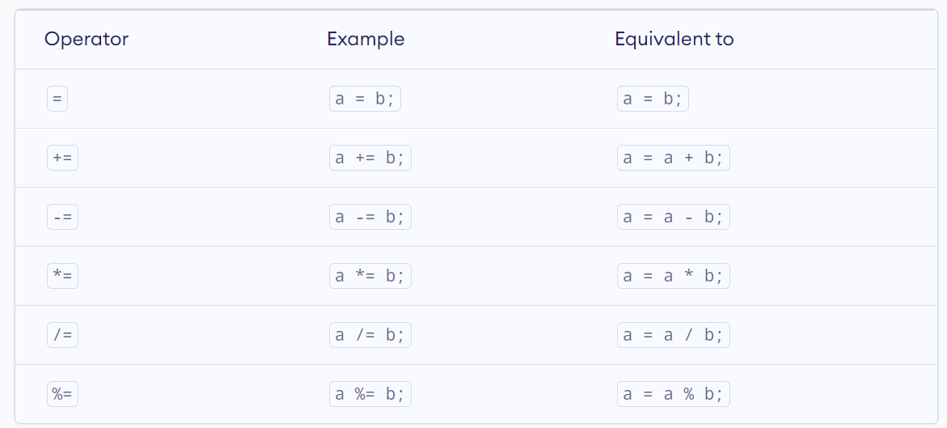
Assignment Operators
LAD
Assignment operators are used to perform Assign the value to the variable

Slide 43
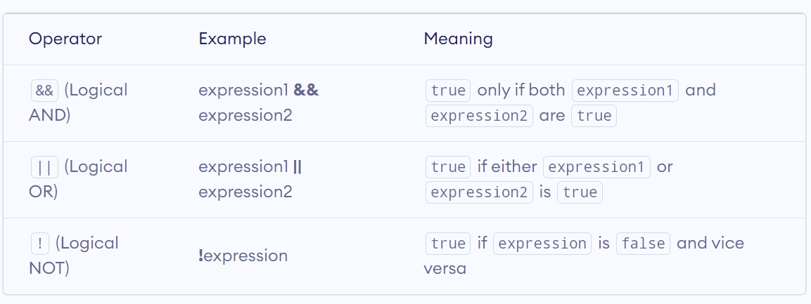
Logical Operators
LAD
Logical Operators are used to check whether the given condition true or false.

Slide 44
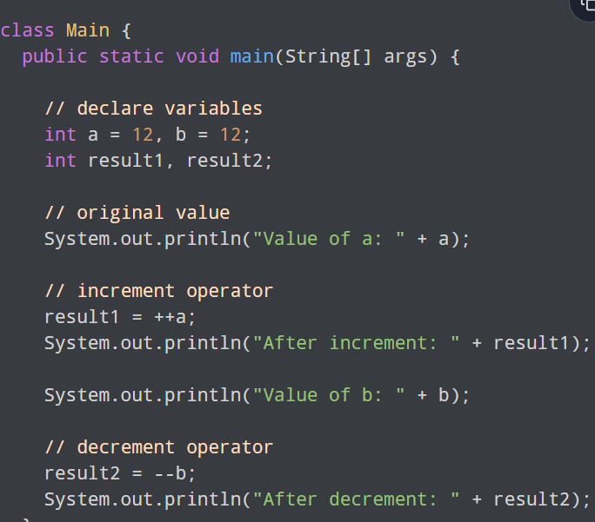
Inc/Dec Operators
LAD
Java also provides increment and decrement operators ++ and – respectively. ++ increases the value of the operand by 1, while – decrease it by 1.

Slide 45
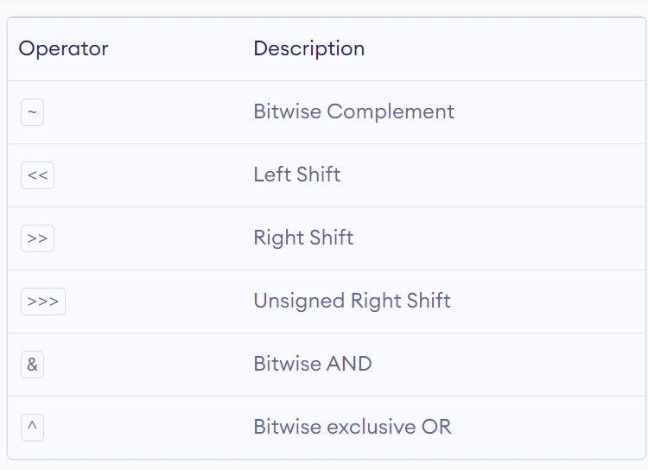
Bitwise Operators
LAD
Bitwise operators in Java are used to perform operations on individual bits.

Slide 46
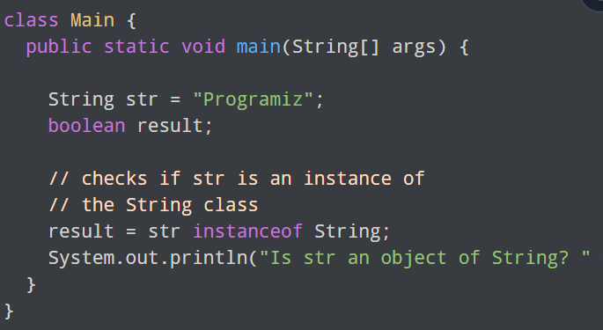
Special Operators
LAD
Dot Operator:- The dot operator is used to access the instance variables and methods of class object
Ex:- student.age();
Instanceof Operator:-The instance of Operator is used to check whether an object is an instanceof a particular class.

Slide 47
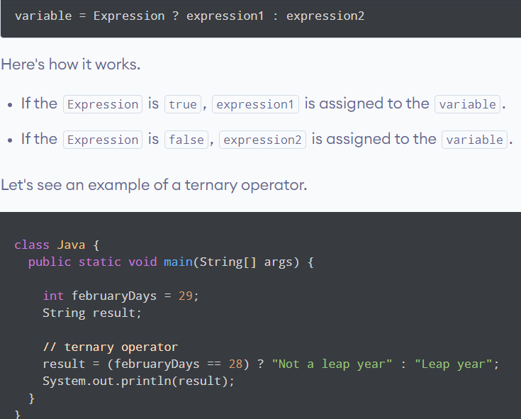
Ternary Operators
LAD
The Ternary Operator(conditional operator)is shorthand for the if-then-else statement.

Slide 48
Operator Precedence
LAD
The operator precedence represents how two expressions are bind together. In an expression, it determines the grouping of operators with operands and decides how an expression will evaluate.
While solving an expression two things must be kept in mind the first is a precedence and the second is associativity.
Precedence
Precedence is the priority for grouping different types of operators with their operands. It is meaningful only if an expression has more than one operator with higher or lower precedence. The operators having higher precedence are evaluated first. If we want to evaluate lower precedence operators first, we must group operands by using parentheses and then evaluate.

Slide 49
Operator Precedence
LAD
Associativity
We must follow associativity if an expression has more than two operators of the same precedence. In such a case, an expression can be solved either left-to-right or right-to-left, accordingly.

Slide 50
Control Statements
LAD
The if-statement is a powerful decision making statement and is used to control the flow of execution of statements. It is basically two way decision making statements.
In java there are 4 types of if-statements.
Simple-if
If-else
Nested-if
Else-if ladder

Slide 51
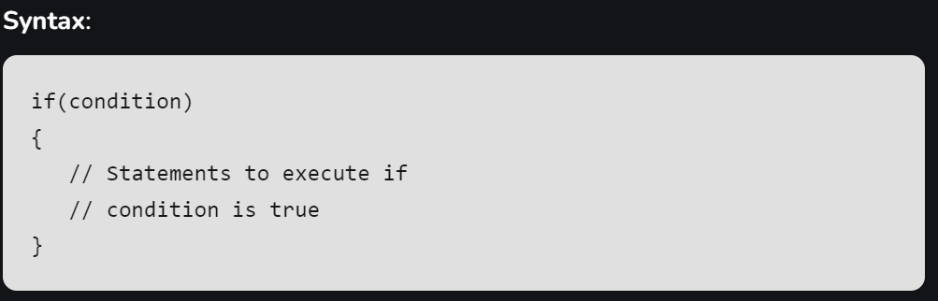
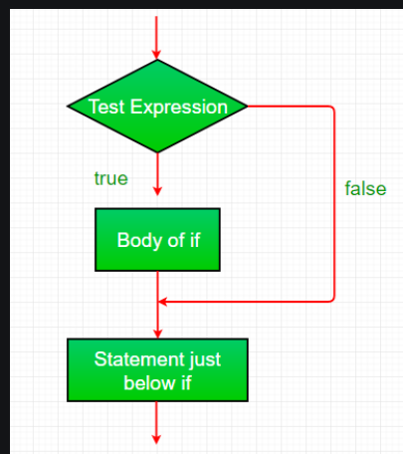
Control Statements
LAD
if: if statement is the most simple decision-making statement. It is used to decide whether a certain statement or block of statements will be executed or not i.e if a certain condition is true then a block of statements is executed otherwise not.

Slide 52
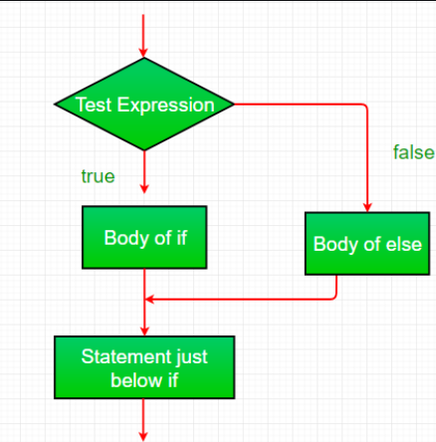
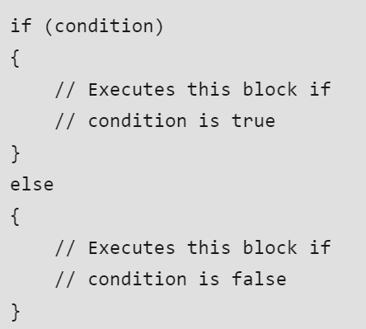
If-Else Statements
LAD
if-else: The if statement alone tells us that if a condition is true it will execute a block of statements and if the condition is false it won’t. But what if we want to do something else if the condition is false? Here comes the else statement. We can use the else statement with the if statement to execute a block of code when the condition is false.

Slide 53
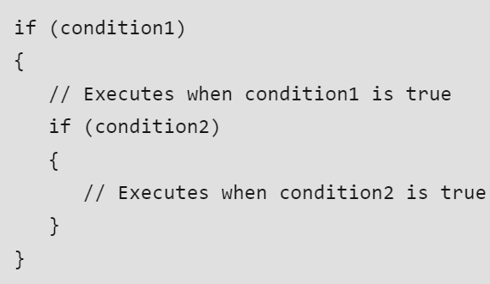
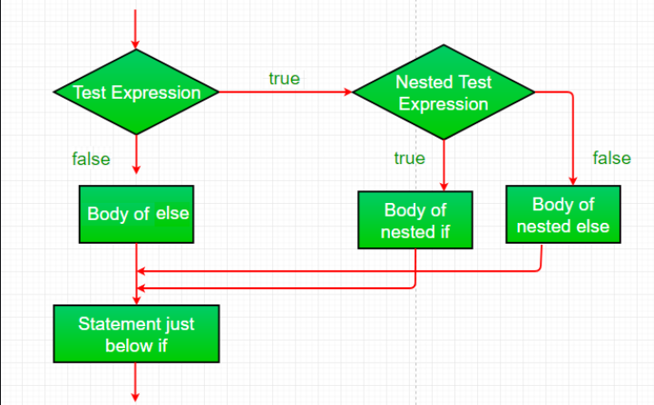
Nested-If Statement
LAD
Nested-if: A nested if is an if statement that is the target of another if or else. Nested if statements mean an if statement inside an if statement. Yes, java allows us to nest if statements within if statements. i.e, we can place an if statement inside another if statement.

Slide 54
Nested-If Statement
LAD
Nested-if: A nested if is an if statement that is the target of another if or else. Nested if statements mean an if statement inside an if statement. Yes, java allows us to nest if statements within if statements. i.e, we can place an if statement inside another if statement.

Slide 55
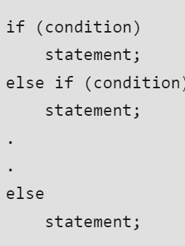
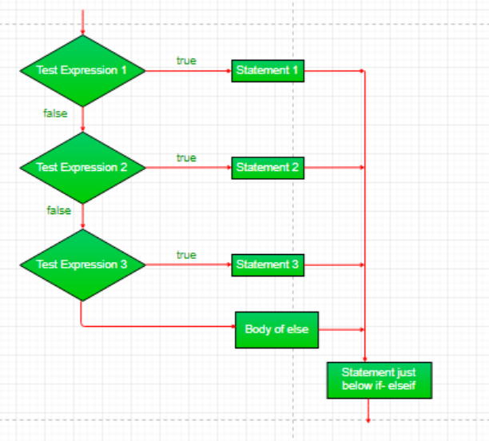
If-Else-If Ladder Statement
LAD
if-else-if ladder: Here, a user can decide among multiple options.The if statements are executed from the top down. As soon as one of the conditions controlling the if is true, the statement associated with that ‘if’ is executed, and the rest of the ladder is bypassed. If none of the conditions is true, then the final else statement will be executed. There can be as many as ‘else if’ blocks associated with one ‘if’ block but only one ‘else’ block is allowed with one ‘if’ block.

Slide 56
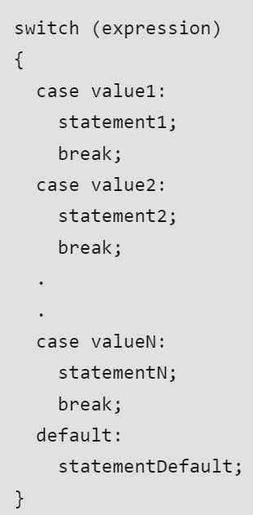
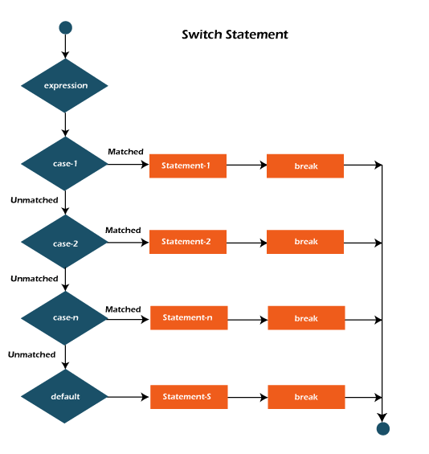
Switch Case
LAD
switch-case: The switch statement is a multiway branch statement. It provides an easy way to dispatch execution to different parts of code based on the value of the expression.

Slide 57
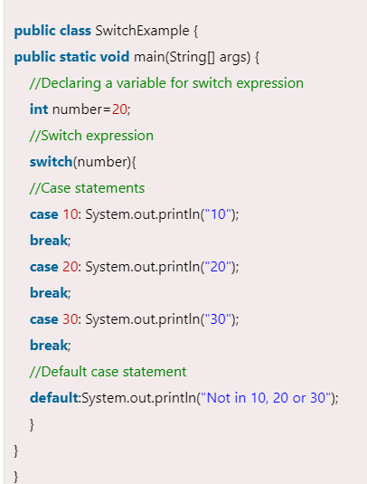
Switch Case
LAD

Slide 58
Decision Making & Looping
LAD
A program loop consists of two segments known as (1) body of the loop (2) control statements.
The control statement contains some conditions and then directs of repeated eexecution of the statement containing in the body of the loop
Depending on the position on the control statement in the loop. A control structure may be classified
Entry controlled loop (for/while)
Exit-Controlled Loop(do-while0

Slide 59
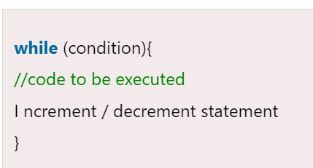
While Loop
LAD
The java while loop is used to iterate a part of the program repeatedly until the specified boolean condition is true. As soon as the boolean condition becomes false, the loop automatically stops.
The while loop is considered as a repeating if statement. If the number of iteration is not fixed, it is recommended to use the while loop.
Syntax:

Slide 60
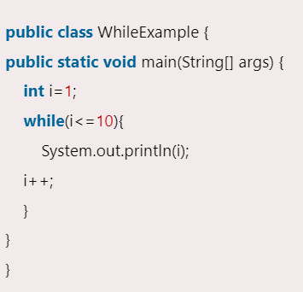
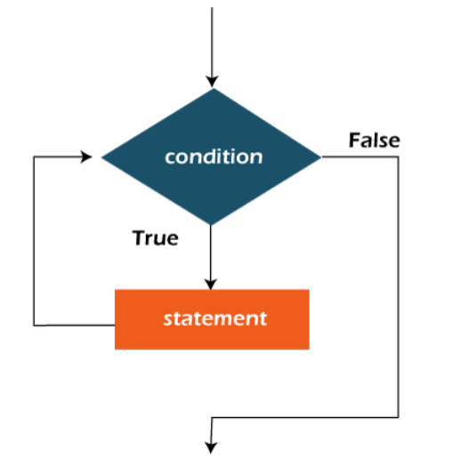
While Loop
LAD
Flowchart of java while loop
Here, the important thing about while loop is that, sometimes it may not even execute. If the condition to be tested results into false, the loop body is skipped and first statement after the while loop will be executed.

Slide 61
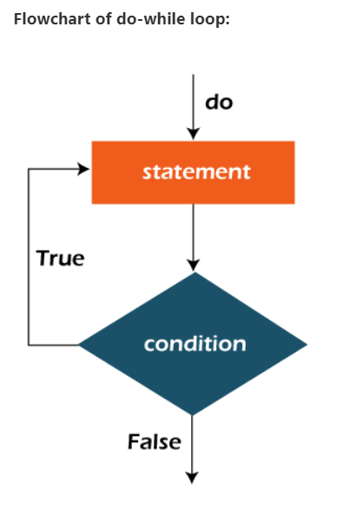
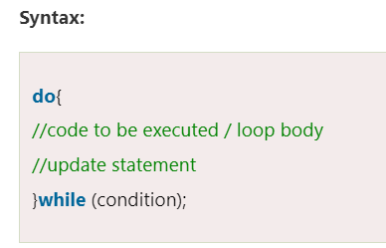
Do-While Loop
LAD
The java do-while loop is used to iterate a part of the program repeatedly, until the specified condition is true. If the number of iteration is not fixed and you must have to execute the loop at least once, it is recommended to use a do-while loop.
Java do-while loop is called an exit control loop. Therefore, unlike while loop and for loop, the do-while check the condition at the end of loop body. The java do-while loop is executed at least once because condition is checked after loop body.

Slide 62
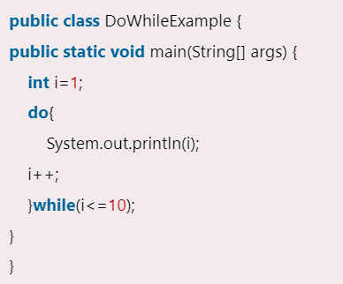
Do-While Loop
LAD
The java do-while loop is used to iterate a part of the program repeatedly, until the specified condition is true. If the number of iteration is not fixed and you must have to execute the loop at least once, it is recommended to use a do-while loop.
Java do-while loop is called an exit control loop. Therefore, unlike while loop and for loop, the do-while check the condition at the end of loop body. The java do-while loop is executed at least once because condition is checked after loop body.

Slide 63
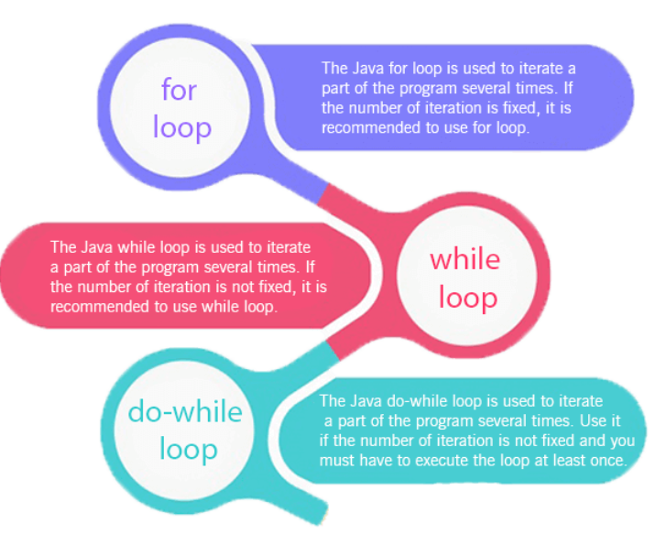
For Loop
LAD
The java for loop is used to iterate a part of the program several times. If the number of iteration is fixed, it is recommended to use for loop.
There are three types of for loops in java.

Slide 64
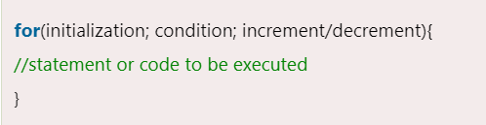
For Loop
LAD
Simple for loop
For-each or enhanced for loop
Labeled for loop
Java simple for loop
A simple for loop is the same as C/C++. We can initialize the variable, check condition and increment/decrement value. It consists of four parts:
Initialization: it is the initial condition which is executed once when the loop starts. Here, we can initialize the variable, or we can use an already initialized variable. It is an optional condition.
Condition: it is the second condition which is executed each time to test the condition of the loop. It continues execution until the condition is false. It must return boolean value either true or false. It is an optional condition.
Increment/decrement: it increments or decrements the variable value. It is an optional condition.
Statement: the statement of the loop is executed each time until the second condition is false.

Slide 65
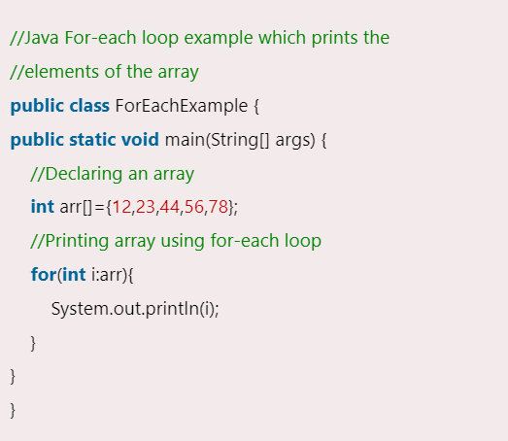
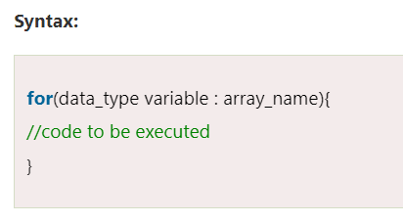
For-each Loop
LAD
Java for-each loop
The for-each loop is used to traverse array or collection in java. It is easier to use than simple for loop because we don't need to increment value and use subscript notation.
It works on the basis of elements and not the index. It returns element one by one in the defined variable.

